Slide 1
ORAL MOTOR TREATMENT OF SIALORRHEA

Slide 2
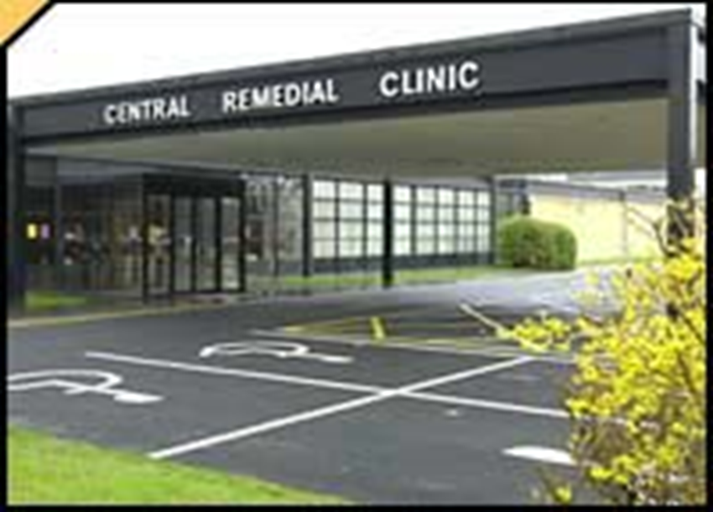
WHERE WE WORK

Slide 3
CRC SERVICES
Birth to Adults
Locations:
  Clontarf
  Clondalkin
  Waterford
National Service
School:
  Clontarf
  Clondalkin

Slide 4

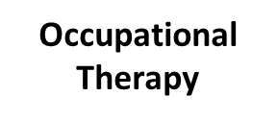
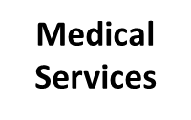


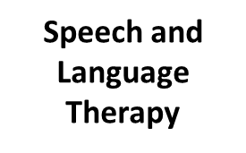

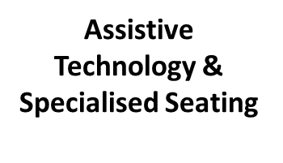
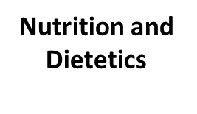

CRC CLONTARF DEPARTMENTS
Central Remedial Clinic Team members

Slide 5
CONTENT
CRC’S Saliva Control Clinic.
Facts
Assessment
Oral-motor Therapy
  CRC Saliva Control Clinic
  Other approaches
  Cases

Slide 6
SIALORRHOEA
Definition:
“Where saliva is present beyond the lip margins”
(Fairhurst and Cockerill 2010)

Slide 7
CRC SALIVA CONTROL CLINIC
Referrals from CRC School SLTs
Prioritised using the Johnson & Scott
Drooling Rating Scale.
Inclusion / exclusion criteria applied
Assessment:
Block of 6 therapy sessions
Review 3, 6, 9 and 12 months.

Slide 8
CURRENT SERVICE
Assessment / Review
Home programme

Slide 9
EXCLUSION CRITERIA
Aspiration
Medication known to increase saliva production
ENT issues negatively affecting drooling
Cognitive level so cannot cooperate with assessment or
therapy
Behaviour difficulties
Parent or carer unavailable to attend sessions and
complete home carryover.

Slide 10
PATHWAYS
Oromotor targeting function and sensory issues
Oromotor targeting, function and sensory with dental appliances
Oromotor and medication
Oromotor and Botox
Surgery

Slide 11
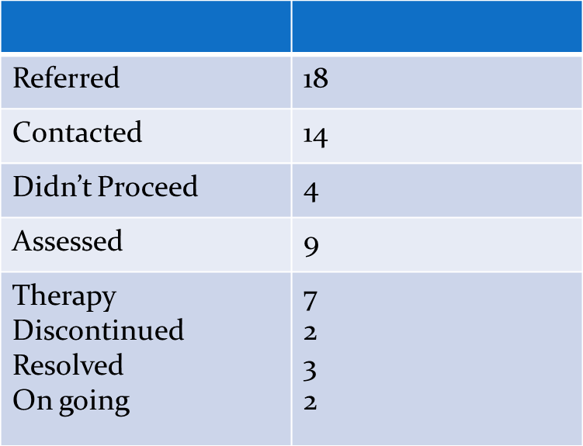

THE CLINIC

Slide 12
FACTS
By 15 months usually only when eating or drinking or fine motor activities.
May drool up to age 3
Beyond 4, drooling is abnormal
(Fairhurst & Cockerill 2010)
Adults swallow 1,000 – 2,000 times per day (Winstock 2005)

Slide 13
CAUSES
Oromotor difficulties related to:
- Medical diagnosis
- Motor disorder
- Neurodevelopmental issues
Medication
Nasal blockage
Oral cavity issues

Slide 14
ORAL MOTOR AND BEHAVIOURAL TREATMENTS
ARE A VIABLE FIRST OPTION BEFORE MORE
INTRUSIVE STRATEGIES
(Van der Burg 2008)
57% USE ORAL MOTOR THERAPY, 52% SIMULATE THE SWALLOW AND WORK ON DESENSITIZATION
(Chaleat-Valeyer et al 2016)

Slide 15
CAUTION

Slide 16
“The evidence base for oromotor therapy is very limited particularly in children with severe disability”
(Fairhurst & Cockerill 2010)
No Randomized controlled studies or clinically controlled studies
(Walshe et al 2012)

Slide 17
CONSIDER
Severity of drooling
Type of drooling
Oromotor ability
Age
Intellectual ability
Motivation / compliance
Multidisciplinary Team

Slide 18
CONTRIBUTING FACTORS
Malocclusion
GOR
Seating
Nasal blockage

Slide 19
ASSESSMENT
Assessment tools used vary widely.
Objective assessment tools used less
Chaleat-Valayer et al 2016

Slide 20
ASSESSMENTS
Nordic Orofacial Test-Screening (NOT-S)
Saliva control assessment questionnaire
Record of previous management form
Frequency and severity of drooling rating scale completed by SLT, home and school
Informal assessment tasks for example, voluntary swallow, sensory awareness, lip and tongue movement

Slide 21
ASSESSMENTS
The Drooling Impact Scale (Reid et al 2010)
Only validated assessment sensitive to
change
  (Chaleat-Valayer et al 2016)
Drooling Quotient
  DQ10 and DQ5
                ( van Hulst et al 2012)

Slide 22
ORAL MOTOR TREATMENT
SESSION
Gross motor.
Oral massage.
Specific oral motor exercises.
Specific speech and language activities.
(Bahr 2001)

Slide 23
ORAL MOTOR IMPAIRMENT AND SIALORRHOEA
Related to:
Lack of awareness of saliva.
Jaw stability and strength
Inefficient tongue movement
Poor lip closure.
Inefficient voluntary swallowing

Slide 24
OUR SENSORY THERAPY
Facial and intra oral massage helps to:
Increase facial and intra oral sensation and awareness
Normalise muscle tone

Slide 25
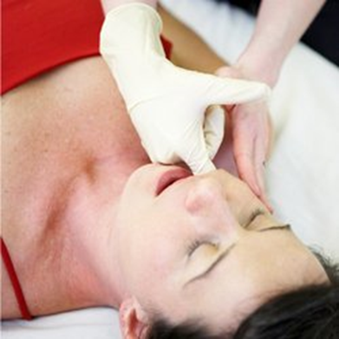
SENSORY WORK
Facial massage
Intra oral massage
Awareness of touch
Comprehension of wet and dry
Awareness of wet and dry
Awareness of saliva on lips and chin

Slide 26
OTHER APPROACHES
Vibratory stimulation
Feeding therapy
Use different textures

Slide 27
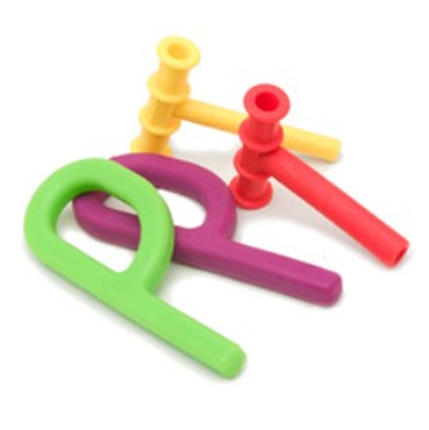
JAW
Red to yellow Chewy Tube
Purple to green Arc Grabber
Criterion: 5 – 10 times left and right 5 times a day
Twice on the weaker side to once on the stronger side

Slide 28
AIMS OF ORAL SCREENS
To improve nasal breathing
To reduce drooling
To prevent oral habits
To strengthen orbicularis oris and constrictor muscles of the pharynx

Slide 29
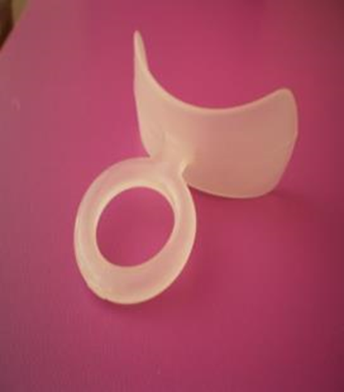
LIP CLOSURE
Active training twice a day
Passive training once a day
5 days a week

Slide 30
VOLUNTARY SWALLOW
Goal:
To develop the ability to manage saliva by
swallowing as needed.

Slide 31
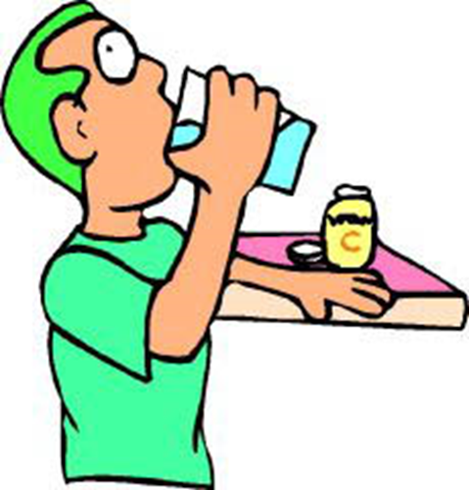
VOLUNTARY SWALLOW
Swallow on command
For a 10 minute period, remind to swallow
10 times a day, ask the child if they need to swallow

Slide 32
OTHER
Mouthing Habits:
Environmental engineering
General carryover games
Mouth wiping technique

Slide 33
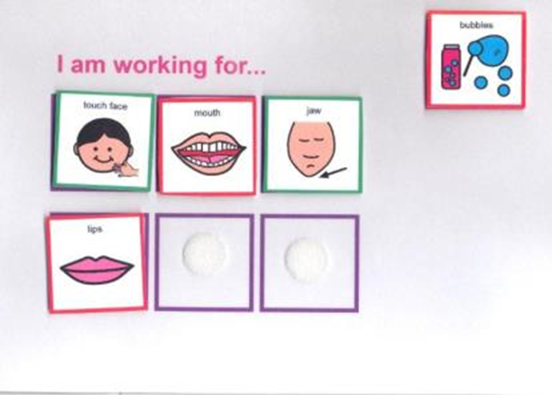
VISUAL SCHEDULE

Slide 34
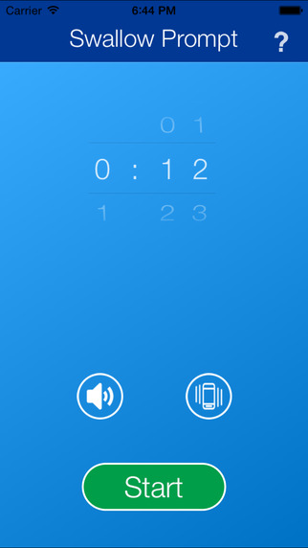
Swallow Prompt APP

Slide 35
ANOTHER APPROACH
TalkTools
(Sarah Rosenfeld-Johnson)

Slide 36
TALKTOOLS
Consider:
Body posture
Sensory awareness
Feeding Therapy
Straw Drinking Hierarchy
Oralmotor Exercises

Slide 37
CASE 1 - ANDREW
Background:
Chronological Age: 5 years 10 months
Medical Diagnosis: Cerebral Palsy, spastic diplegia and epilepsy and CVI
Medication: Trileptal and Baclofen
Cognitive Level: Borderline
NOT-S – Interview 3, examination 6
Severity reported: Mild to moderate, observed dry. Frequency: occasional

Slide 38
ISSUES
Hypersensitive
Poor oral hygiene and dental decay
Habitual mouth breather
Head position forward
No bilateral muscle bunching in the jaw
Weak lip closure
Voluntary swallow not observed

Slide 39
PLAN
Refer to the Dentist
Liaise with physiotherapy re: seating
Liaise with Paediatrician re: vision
Facial and intra oral massage
Oral screen
Develop voluntary swallowing
Environment: Book stand
Wiping technique

Slide 40
OUTCOME
Poor outcome post therapy:
  Severe drooling, clothes were wet
  Now reporting intra oral pain
  New report of mouthing fingers
  3 months - little change, some evidence
  of profuse drooling.
  Awaiting new chair
  Still not seen the dentist

Slide 41
6 MONTHS
2 in 7 days dry
Had seen the dentist
New chair resulting in improved head position
Had continued to use the oral and facial
massage

Slide 42
CASE 2 - ROB
Background:
5 years 8 months
Medical diagnosis: Cerebral Palsy, spastic diplegia; cognitive level average
Medication: Baclofen 10mgs twice daily
NOT-S assessment examination 4, interview 2
Severity reported: moderate to profuse
Observed: mild to moderate
Frequency reported: Frequent
Attended initial assessment therapy review and 3 months review, 6 months a telephone call and 15 months at telephone call.

Slide 43
MAIN ISSUES
No bilateral muscle bunching of the jaw
No lateral tongue movement / difficulty
chewing
Mouth stuffing – query hyposensitive

Slide 44
POSITIVE FINDINGS
Habitual lip closure present
Achieved one swallow on command
Mild class 2 malocclusion not affecting lip
closure

Slide 45
PLAN
Facial and intra oral massage
Yellow Chewy tube proceeding to purple Ark Grabber twice on the left to once on the right
Voluntary swallow 5 times increasing to 10 times per day on command
Mouth wiping technique
Concepts of wet and dry
Environment: Use easel/bookstand
Self-monitoring in games

Slide 46
OUTCOME
Sensory awareness of wet and dry on lips and chin
Less food stuffing
Improved jaw strength achieved 10 bite/ release with the purple Ark Grabber
Voluntary swallow 10 times on request per day
Self-monitoring need to swallow to manage saliva

Slide 47
RESULTS
Dry in session after 6 weeks
6 months – dry for 4 days per week
Father not concerned
15 month telephone – no concerns dry for 3
months

Slide 48
CONCLUSIONS
Lack of evidence base for oromotor therapy
Research needed
Viable option for some clients
Timely oromotor programme
Trial for 4 – 5 months
MDT needed

Slide 49

THANK YOU

